Slide 1
Systems Analysis And Design
Chapter Five: Implementation and Operation

Slide 2
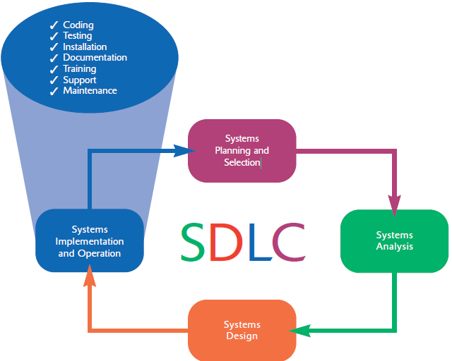

Slide 3
System Imp’n and Oper’n (Cont.)
Purpose:
  To convert final physical system specifications into working and reliable software
  To document work that has been done
  To provide help for current and future users
  To modify the system to entertain changes

Slide 4
The Process of Coding, Testing, and Installation
Coding
  Physical design specifications are turned into working computer code.
Testing
  Tests are performed using various strategies.
  Testing is performed in parallel with coding.
Installation
  The current system is replaced by a new system.

Slide 5
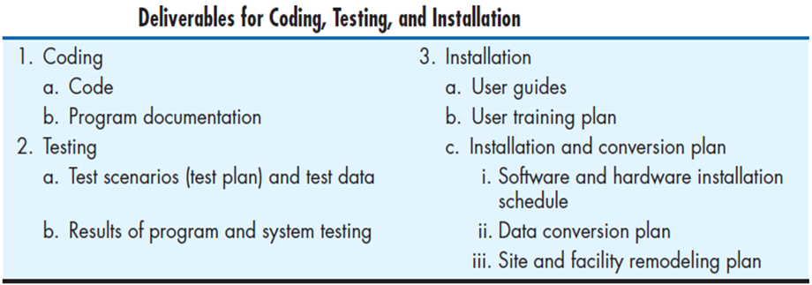

Slide 6
Documenting the System, Training Users, and Supporting Users
Two audiences for final documentation:
  Information systems personnel who will maintain the system throughout its productive life
  People who will use the system as part of their daily lives
User Training
  Application-specific
  General for operating system and off-the-shelf software

Slide 7
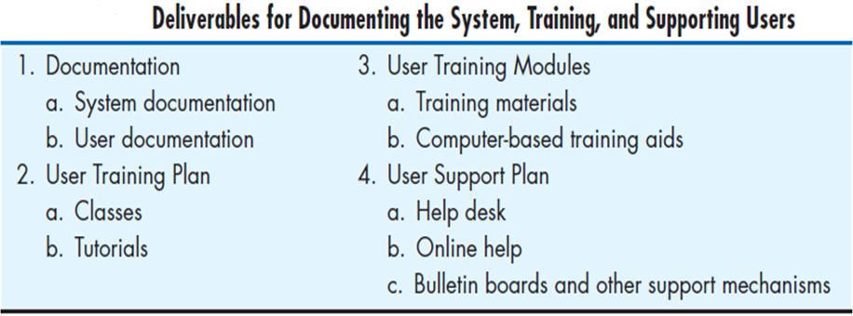

Slide 8
The Process of Maintaining Information Systems
Four major activities occur within maintenance:
  Obtaining maintenance requests
  Transforming requests into changes
  Designing changes
  Implementing changes
Deliverables and outcomes of this process are:
  the development of a new version of the software
  new versions of all design documents
  training materials developed or modified during the maintenance process.

Slide 9
Software Testing
A master test plan is developed during the analysis phase.
During the design phase, unit, integration and system test plans are developed.
The actual testing is done during implementation.
Written test plans provide improved communication among all parties involved in testing.

Slide 10
Seven Different Types of Tests
Static or dynamic techniques
  Static testing means that the code being tested is not executed.
  Dynamic testing involves execution of the code.
Test is automated or manual
  Automated means computer conducts the test.
  Manual means that people complete the test.

Slide 11
Seven Different Types of Tests
Inspection: a testing technique in which participants examine program code for predictable language-specific errors
Walkthrough: a peer group review of any product created during the systems development process, including code
Desk checking: a testing technique in which the program code is sequentially executed manually by the reviewer

Slide 12
Seven Different Types of Tests (Cont.)
Unit testing: each module is tested alone in an attempt to discover any errors in its code
Integration testing: the process of bringing together all of the modules that a program comprises for testing purposes
  Modules are typically integrated in a top-down incremental fashion.

Slide 13
Seven Different Types of Tests (Cont.)
System testing: the bringing together of all of the programs that a system comprises for testing purposes
  Programs are typically integrated in a top-down, incremental fashion.
System testing is also about testing if the system meets its objective.

Slide 14
Seven Different Types of Tests (Cont.)
Stub testing: a technique used in testing modules, especially where modules are written and tested in a top-down fashion, where a few lines of code are used to substitute for subordinate modules

Slide 15
The Testing Process
The purpose of testing is to confirm that the system satisfies the requirements.
Testing must be planned.
  Test case is a specific scenario of transactions, queries or navigation paths.

Slide 16
The Testing Process (Cont.)
Test cases represent either:
  Typical system use
  Critical system use, or
  Abnormal system use.
Test cases and results should be thoroughly documented so they can be repeated for each revision of an application.

Slide 17
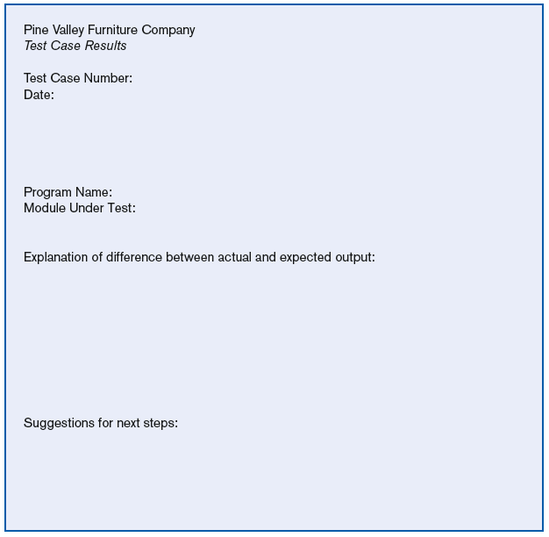
Test case results form

Slide 18
Testing Harness
Automated testing environment
Reviews code for:
  Errors
  Standards violations
  Other design flaws
Expand the scope of the tests beyond the current development platform

Slide 19
Acceptance Testing by Users
Acceptance testing: the process whereby actual users test a completed information system, the end result of which is the users’ acceptance of it

Slide 20
Acceptance Testing by Users (Cont.)
Alpha testing: user testing of a completed information system using simulated data
Beta testing: user testing of a completed information system using real data in the real user environment

Slide 21
Acceptance Testing by Users (Cont.)
Types of Alpha Test:
  Recovery testing — forces software (or environment) to fail in order to verify that recovery is properly performed
  Security testing — verifies that protection mechanisms built into the system will protect it from improper penetration
  Stress testing — tries to break the system
  Performance testing — determines how the system performs on the range of possible environments in which it may be used

Slide 22
Installation
Installation: the organizational process of changing over from the current information system to a new one
Four installation strategies:
  Direct Installation
  Parallel Installation
  Single-location installation
  Phased Installation

Slide 23
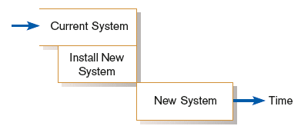
Direct Installation
Direct installation: changing over from the old system to a new one by turning off the old system when the new system is turned on

Slide 24
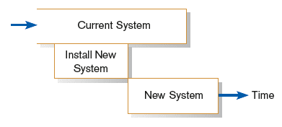
Parallel Installation
Parallel installation: running the old information system and the new one at the same time until management decides the old system can be turned off

Slide 25
Single-Location Installation
Single-location installation: trying out an information system at one site and using the experience to decide if and how the new system should be deployed throughout the organization
Also known as location or pilot installation

Slide 26
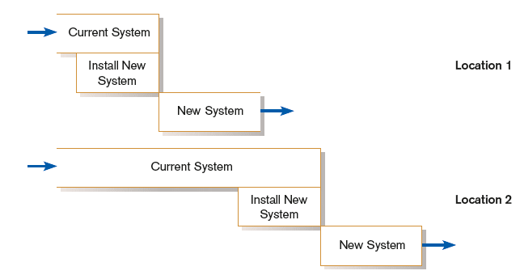
Single-Location Installation (cont.)

Slide 27
Phased Installation
Phased Installation: changing from the old information system to the new one incrementally, starting with one or a few functional components and then gradually extending the installation to cover the whole new system

Slide 28
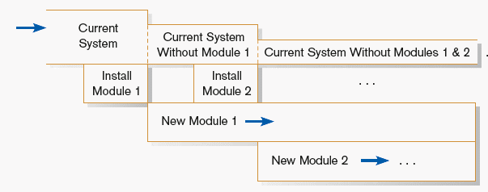
Phased Installation (cont.)

Slide 29
Planning Installation
Considerations
  Data conversion
    Error correction
    Loading from current system
  Planned system shutdown
  Business cycle of organization

Slide 30
Documenting the System
System documentation: detailed information about a system’s design specifications, its internal workings, and its functionality
User documentation: written or other visual information about an application system, how it works, and how to use it

Slide 31
Documenting the System (Cont.)
Internal documentation: system documentation that is part of the program source code or is generated at compile time
External documentation: system documentation that includes the outcome of structured diagramming techniques such as data flow and E-R diagrams

Slide 32
Training and Supporting Users
Support: providing ongoing educational and problem-solving assistance to information system users
For in-house developed systems, support materials and jobs will have to be prepared or designed as part of the implementation process.

Slide 33
Training Information Systems Users
Potential training topics
  Use of the system
  General computer concepts
  Information system concepts
  Organizational concepts
  System management
  System installation

Slide 34
Types of Training Methods
Resident expert
Traditional instructor-led classroom training
E-learning, distance learning
Blended learning (instructor plus e-learning)
Software help components

Slide 35
Training Information Systems Users (Cont.)
Electronic performance support system (EPSS): component of a software package or an application in which training and educational information is embedded
An EPSS can take several forms, including a tutorial, an expert system shell, and hypertext jumps to reference materials.

Slide 36
Supporting Information Systems Users
Support is important to users.
Providing support can be expensive and time-consuming.
Organization tend to rely on Vendors for support as they move towards using sophisticated systems.

Slide 37
Automating Support
One approach is through automation.
  Internet-based online support forums
  Voice response systems
  Knowledge bases

Slide 38
Providing Support Through a Help Desk
Help desk: a single point of contact for all user inquiries and problems about a particular information system or for all users in a particular department

Slide 39
Providing Support Through a Help Desk (Cont.)
Requires
  Technical skills: extensive knowledge about how to use the system and typical problems that can be encountered
  People skills: good listening and communication, dealing with complaints and frustrations

Slide 40
Organizational Issues in Systems Implementation
Why does implementation sometimes fail?
Traditional wisdom of primary success factors:
  Management support
  User involvement
  But these are not enough
Other important factors
  Commitment to project
  Commitment to change
  Extent of project definition and planning

Slide 41
Factors Influencing System Use
Personal stake of users
System characteristics
User demographics
Organizational support
Performance
Satisfaction

Slide 42
Project Close-Down
Evaluate team.
  Reassign members to other projects.
Notify all affected parties that the development project is ending and that you are switching to operation and maintenance mode.
Conduct post project reviews.
Close out customer contract.
  Formal signoff

Slide 43
Conducting Systems Maintenance
Maintenance refers to changes made to a system to fix or enhance its functionality.
A significant portion of an organization’s budget for information systems goes to the maintenance of existing systems.

Slide 44
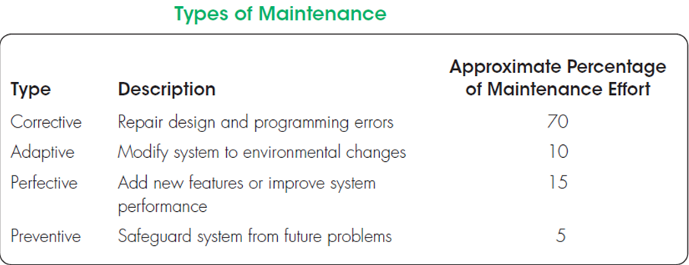

Slide 45
The Cost of Maintenance
Information systems maintenance costs are a significant expenditure.
Maintainability is the ease with which software can be understood, corrected, adapted, and enhanced.
Systems with low maintainability result in uncontrollable maintenance expenses.

Slide 46
The Cost of Maintenance cont’d..
Factors influencing the maintainability of a system:
  Latent defects: This is the number of unknown errors existing in the system after it is installed.
  Number of customers for a given system: In general, the greater the number of customers, the greater the maintenance costs.
  Quality of system documentation: Without quality documentation, maintenance effort can increase exponentially.
  Maintenance personnel
  Tools
  Well-structured programs

Slide 47
Other Maintenance Issues
Measuring maintenance effectiveness
  Number of failures
  Time between each failure
  Type of failure
Controlling maintenance requests
  Categorization
  Prioritization
Configuration management: the process of ensuring that only authorized changes are made to a system

